Slide 1

Microsoft Azure Service Bus
Varun Kumar
me@varunkumar.in
http://CloudAvenue.in/

Slide 2

Agenda
What are Messaging Queues?
Its Need
Azure Offerings
Demo
Service Bus Architecture
Limits and Quotas

Slide 3
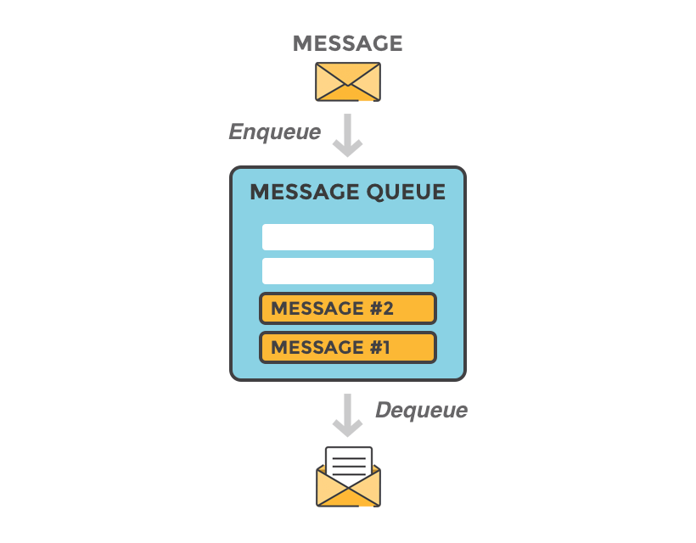
Messaging Queues
Notes:
Integration
Security
Productivity
Batching
FIFO
Eg: RabbitMQ, Amazon Simple Queue Service (SQS), Kafka
Advanced Message Queuing Protocol

Slide 4
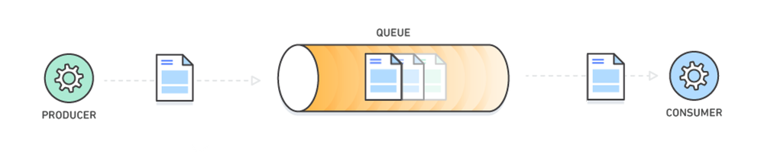
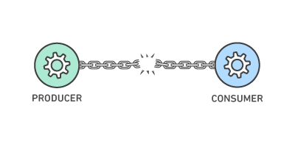
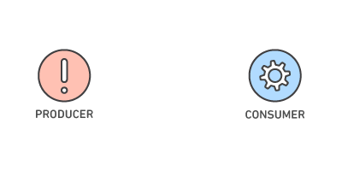
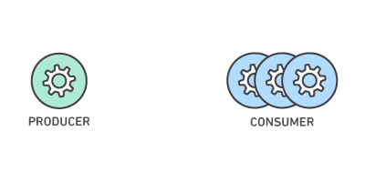

Messaging Queues (Contd..)
Medium of information Exchange
Simplified Decoupling Reliability
Granular Scalability
Notes:
Integration
Security
Productivity
Batching
FIFO
Eg: RabbitMQ, Amazon Simple Queue Service (SQS), Kafka

Slide 5





Point to point system
Sender
Receiver

Slide 6

Service Bus
Queues
Topics
Relays
Brokered Messaging

Slide 7
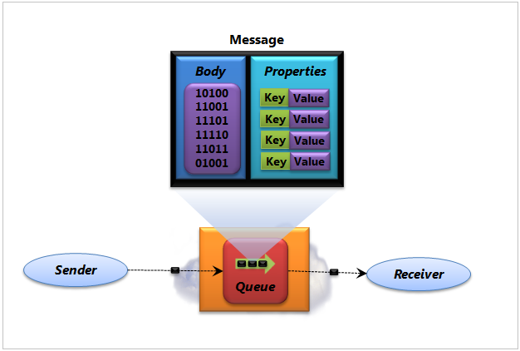
Queues
Guarantees FIFO
Message Receive
ReceiveAndDelete
PeekLock
Single Receiver
Unique MessageID
Notes:
Although they are called queues. Not all of them guarantees FIFO

Slide 8
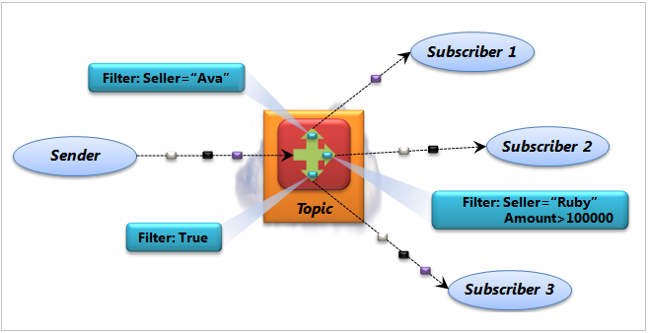
Topics
Publish & Subscribe
(pub/sub)
Subscription
Filter
Multiple Receivers

Slide 9
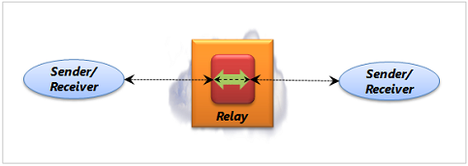
Relays
Two way communication
Requires both Sender and
Receiver to be live
Created and deleted
Automatically

Slide 11
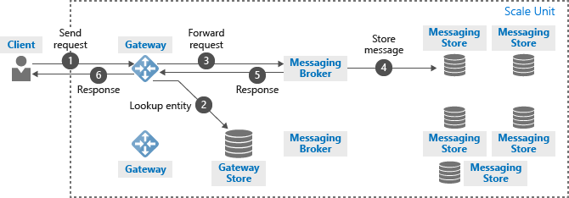
Service Bus Architecture

Slide 12
Limits and Quotas
Limit/Quota Name | Value
Queue/topic size | 1, 2, 3, 4 or 5 GB. If partitioning is enabled - 80 GB.
Number of concurrent connections | NetMessaging: 1,000 AMQP: 5,000
Number of topics/queues per service namespace | 10,000
Number of partitioned topics/queues per service namespace | Basic and Standard Tiers - 100 Premium - 1,000 (per messaging unit)
Message size for a queue/topic/subscription entity | Maximum message size: 256KB (Standard tier) / 1MB (Premium tier).
Number of subscriptions per topic | 2,000
Notes:
Advanced Message Queuing Protocol

Slide 13
Some More..
DEAD-LETTER - To handle poisonous messages
Sessions - To send messages greater than 256KB or to send messages that need to be processed together
RenewLock – To extend lock duration
Batching

Slide 14
References
https://docs.microsoft.com/en-us/azure/service-bus-messaging/service-bus-messaging-overview
https://www.knowledgehut.com/blog/cloud-computing/delivering-messages-made-easy-with-azure-service-bus
https://cloudavenue.in/azure-service-bus/
https://cloudavenue.in/2018/08/08/servicebusexplorer/
https://cloudavenue.in/2019/03/22/export-and-import-entities-with-set-configurations-and-authorization-rules-using-servicebus-explorer/

